Slide 1


Cyber Security Investment Strategies: Making the Most of What you Have
David Richards
@Whereduck
Mike Manrod
@CroodSolutions
This Photo by Unknown Author is licensed under CC BY-NC

Slide 2
A Strategy for Cactus Corp
You are the new CISO of Cactus Corp and need to present a strategy to the CIO and CFO at a meeting that has already been scheduled, for six weeks from now.
Select an adversary type to consider.
Choose an initial access scenario to get you started.
Select some Post Exploitation cards to consider and build these into at least one realistic attack path.
Now look at the Defense Cards and consider which ones would be the most effective at preventing compromise and enabling response.
Build these into your strategy and consider how to present these to the executive team to get support and funding.

Slide 3
Attacker Cards

Slide 4

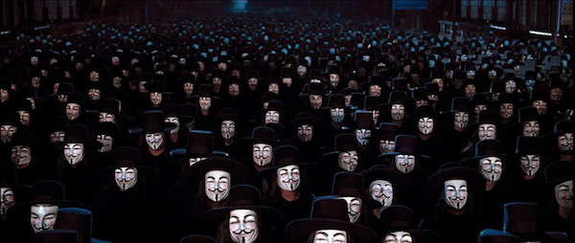


Attacker Card
Cybercriminal
Hacktivist
At this point, the most common malicious activity most organizations see is from cybercriminals, seeking to deploy ransomware, sell data, or steal financial information such as credit cards or crypto currency. Note that sometimes nations will provide safe havens for cyber crime.
Hacktivist groups are groups of people, not always highly organized, using malware and intrusion to help promote an ideology or perspective. For example, hacktivists with a pro-coffee movement could take measures to deface the web sites of tea drinkers.
Nation State Adversary
Insider Threat
These are hacking teams sponsored by nations to attack countries or companies to achieve their objectives, which could range form espionage (spying) to disrupting critical services (making the power go out), or efforts to discredit or harm opponents. This could be at home or abroad, often combined with disinformation.
Sometimes organizations handle resources of great value, such as money or secret information such as the conclusion for the series finale of Stranger Things, the week before it comes out. An insider could seek to steal something of value or could simply trash the place out of spite.
This Photo by Unknown Author is licensed under CC BY-ND

Slide 5
Initial Access Cards

Slide 6

Email Phishing Attack: Credential Theft (roll a one or a two)
Basic Definition
What Happens Next?
The attacker sends an email that looks like something good that you want to open, when really it is a trick. The link is not to the real Microsoft or Amazon; instead, it is to a look-alike site that will prompt you to enter a username and password, which they will enthusiastically steal and use for their own malicious purposes.
Once the attacker has Sally’s username and password, they will try to sign into important software applications that have sensitive data or that could provide them with the ability to hack/compromise more things. They will also share/sell her username and password to other criminals, who are likely to try it on all the popular sites, compromising many other accounts (social media, banks, and so on).
Story / Scenario
A Visual Representation:
Sally is excited to finish training and start working in her new job as a sales rep for Cactus Corp. She believes in the vision of Cactus Corp, and sees herself in her dream job as the sales manager in the corner office one day. Suddenly, she gets an email saying that her employment status needs verification: she clicks the link, enters a username and password, and breathes a sigh of relief that she finished the important task after typing in lots of info.

Slide 7

Email Attack: Bad Attachment / Weaponized Document (roll a three or a four)
Basic Definition
What Happens Next?
The attacker sends an email that includes an attachment that looks like something important and valid, but really it has malware (a computer virus) that gives the criminal control of the user’s computer. Once they have control, they may have the ability steal passwords, activate the camera/mic to spy, or find other important computers close by to attack.
Once Joe has opened the attachment, the attacker may try to load other malware and tools, to retain control of his laptop, steal his passwords, and move on to infect other systems. In this case, it could be someone trying to get a foothold into Cactus Corp, so they can deploy ransomware shutting down the company until they pay millions. This devastating attack could cause them to be unable to function for weeks, or longer.
Story / Scenario
A Visual Representation:
Joe is sitting at his desk, trying to finish up email, so he can go take his dog for a walk. He sees a strange attachment from a sender he does not recognize, but opens it to see what it is, so he can close out this very long workday. The document seems like complete garbage, so Joe closes the file and moves on to the next email. Meanwhile, his system has been compromised with malware and his entire company is in danger.

Slide 8
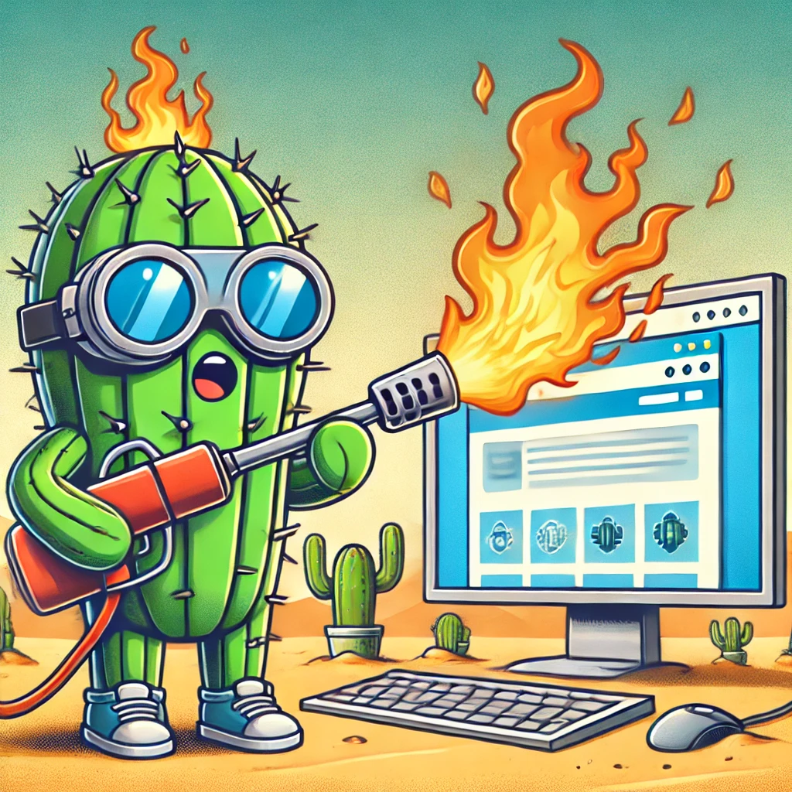
Attack on a Web Site / Computers Hosting a Web Site (roll a five)
Basic Definition
What Happens Next?
The attacker does research to find what web sites Cactus Corp has and learns a considerable amount about these sites and the systems that they run on. They find a flaw in one of the web sites and launch an attack that lets them first get control of the web site, and later the system or cloud instance the web site is running on. This leads right into the technique cards to move laterally and expand reach in the environment.
Once the attacker has compromised one computer, they are likely to see what other systems or services they can exploit across Cactus Corp. Unfortunately, there are a vast number of tools that make this job easier for the attacker. It is up to Cactus Corp to identify and repel the intruder.
Story / Scenario
A Visual Representation:
Cactus Corp had a web site to track customer ideas that they have not thought about in years. It is still running, and you can still find it on the internet, but it looks a little outdated and the security was never a consideration. When the attackers find this web site, they believe they have found their way in – look out Cactus Corp!

Slide 9

Social Engineering: Malicious Caller
Basic Definition
What Happens Next?
Social Engineering is where someone uses their knowledge of human behavior, to manipulate a desired response that helps their attack to succeed. In popular culture and fiction, this is the proverbial smooth talker who can tell a tall tale to get into anywhere; or who can get entranced people to do anything they ask. It is also the person we all block on social media and hide from at parties, once we are on to their schemes.
In this scenario, once they got a user to cooperate in expanding their access, they would continue with their attack until they either succeed or until some other defensive measure catches and stops them. Adversaries that are good at social engineering and willing to employ these tactics can be formidable, because if determined, they can use such tactics to clear roadblocks at multiple stages of the process.
Story / Scenario
A Visual Representation:
An attacker has already phished a set of valid credentials, by sending an email to a user, who fell for it and entered their username and password on an attacker-controlled web site. There was multifactor authentication though, so the password was not enough. Cactus Corp has a culture of being helpful though, so when the attacker called in for support because they could not access Cactus App, the support people kindly gave them access.

Slide 10
Post Exploitation Cards

Slide 11
Escalate Privileges on Host | Compromise Credentials via Responder (LLMNR)
Pivot to Another System via Compromised Account | Query AD for Important Hosts
Pivot to Another Host via Vulnerability or Flaw | Query AD for Important Accounts
Establish Persistence on Host via Scheduled Task | Defense Evasion via DLL Unhooking

Slide 12
Escape to Host | Compromise Credentials via Keylogger
Compromise Windows Credential Store | Compromise Browser Credential Store
Defense Evasion via BYOVD | Compromise Remote Management or Host Management Platform
Establish Persistence on Host by Adding an Account | Defense Evasion via Blinding AV/EDR

Slide 13
Drop a Cobalt Strike or Brute Ratel Beacon (or custom) | Access Records via Exposed S3 Bucket or Storage Blob
Pivot from Cloud to Datacenter via Hybrid Connector or Data Gateway | Compromise Unauthenticated API
PE via Account Impersonation | Insider Threat: After Prior Attempts Fail, Attacker Bribes and Employee.
Lateral Movement via Default Accounts. | Compromise of Out of Band Management (ILO/iDRAC)

Slide 14
Defender Cards

Slide 15
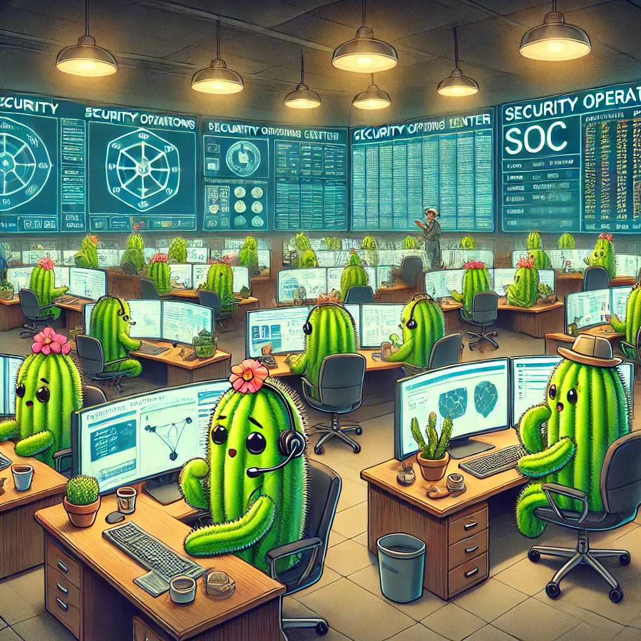

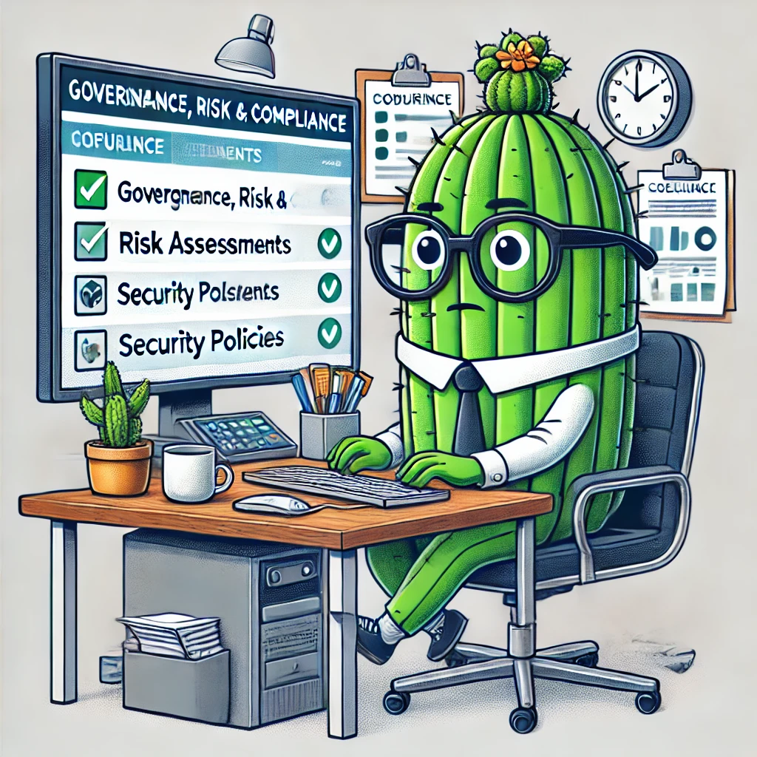
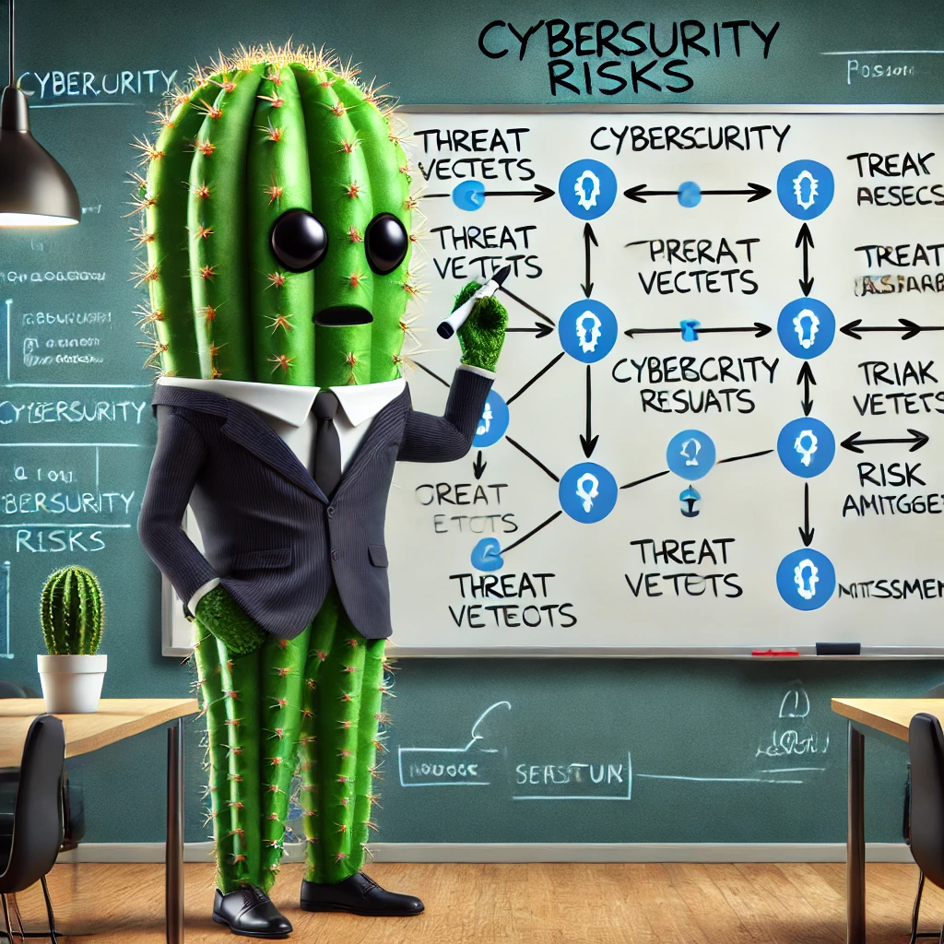
Defender Card (use any/all of these to build your strategy)
SOC / Security Operations Center Analyst (or IR)
Security Administrator / Engineer
These are the warriors who serve as the first responders for inbound attacks. They are like the emergency cyber-medics, performing triage and initiating the process of rendering care to systems, software, or users who may be in trouble. Usually, senior members of such a team also perform purple teaming / internal assessment.
Serving as the experts in rolling out and supporting security products, these are the experts who help deploy the defense controls, and who also keep them working and help to evolve them over time. This is usually someone who is good at problem solving, working with others, and thinking ahead to plan out changes.
GRC Analyst
Security Leader / Architect
These are experts who understand multiple topics including technology, policies, laws, risk levels, and how to help a company make good decisions to stay out of trouble. They are good at anticipating problems from a big-picture perspective, not just about a given technology, but also how each IT decision may impact future results.
Security leaders and architects have to think about how many technologies interact and work together to protect an organization. They need to be able to dive in and understand details, while also maintaining the ability to zoom out and look at the bigger picture. Leaders also manage people; whereas architects focus more on technology.

Slide 16
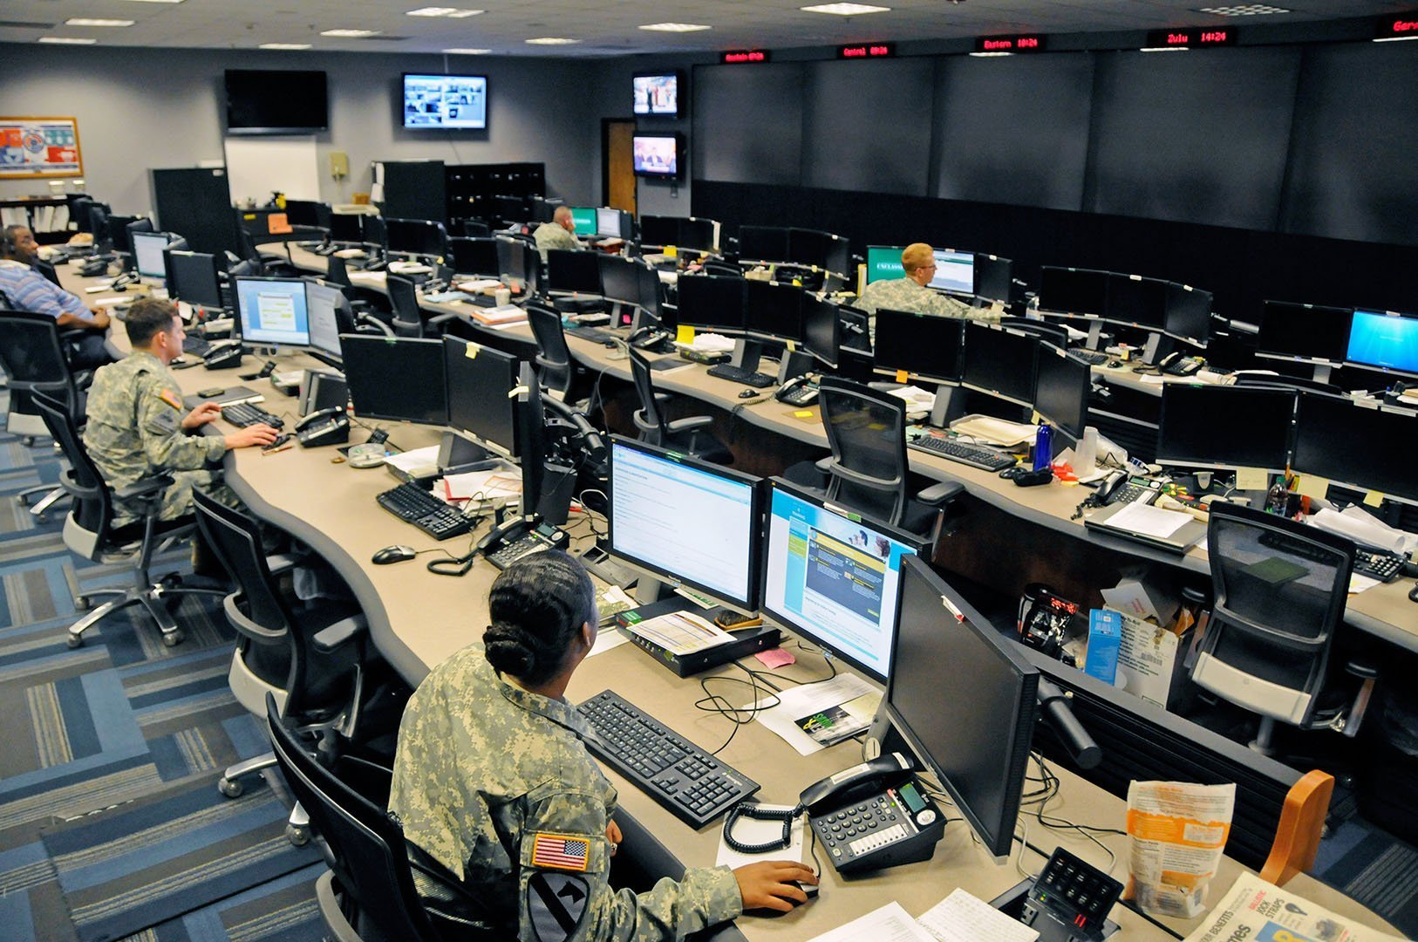



Defender Card (use any/all of these to build your strategy)
Help Desk Analyst
NOC
Help Desk Analysts can ask questions, escalate and/or use tools like Trusona to verify that the user they are about to bypass is legitimate. They can escalate to Help Desk Leadership and IT Security, when in doubt.
The NOC can validate users with Trusona, open a bridge, and escalate to IT Security if account compromise or some other security issue has occurred.
Help Desk Leader
Outside IR / PS Consultant
These leaders are well trained Ninjas, who are very experienced at slicing through a Social Engineering pretext to get down to the real story of what is going on.
This is your phone a friend lifeline for when you do not have sufficient resources or expertise to accomplish your objective.
This Photo by Unknown Author is licensed under CC BY

Slide 17
Defensive Control Cards (these can either be preventative or reactive in nature)

Slide 18
Email Security Gateway | Firewall
Network Segmentation | Micro-segmentation
URL Filtering and DNS Solutions | EDR
Host Firewall | Application Allow-Listing and Script Control

Slide 19
Build an In-House SOC | Contract an Outsourced SOC Provider
Attack Surface Mapping and Management | Setup Reoccurring Meetings on Risk and Vulnerability Remediation
Implement MFA | Conditional Access
Cloud Security Posture Management (CSPM) | ZTNA (Zero Trust Network Access)

Slide 20
PAM and Password Rotation | User Entity Behavior Analytics
User Awareness Training | Phishing Simulation Exercises
Password Complexity Improvements + Hunt for Weak Passwords | Initiate Purple Teaming Program
A Quality Penetration Test | Initiative to Cleanup Technical Debt

Slide 21
Improve SPF/DMARC/DKIM | Implement Asset Management Program
Cleanup Excessive Permissions | Examine Domain Trusts / Review Domain Settings
Evaluate Settings for Cloud and SaaS Providers w/ Application Marketplace | Cloud Security Audit / Assessment.
Disable High-Risk Legacy Protocols | Defense Evasion via DLL Unhooking

Slide 22

Closing Thoughts
By now you have mapped out a realistic attack path that is a serious risk to Cactus Corp – in reality, you would repeat this with multiple scenarios until you feel you have a strong grasp on risks and opportunities to improve.
Solutions have been aligned with stages along the attack path, discussed, and prioritized.
Next you would organize this plan into a strategy document, a slide show, and an executive summary with your formal ask.
I like to organize my plans into three menu options: deluxe, regular, and budget.
This means if something goes wrong involving something that did not get approved on the deluxe plan, you can refer back to that and point it out later when/if you are getting yelled at. Let the CFO and other execs be the one to select the economy plan.

Slide 23
Thank you…
Any Questions?

Slide 24
Blank Slide

Slide 25
Blank Card (conditions)
Basic Definition
What Happens Next?
Info
Info
Story / Scenario
A Visual Representation:
Info

Slide 26
Scenario Title Scenario Description | Scenario Title Scenario Description
Scenario Title Scenario Description | Scenario Title Scenario Description
Scenario Title Scenario Description | Scenario Title Scenario Description
Scenario Title Scenario Description | Scenario Title Scenario Description

